Slide 1
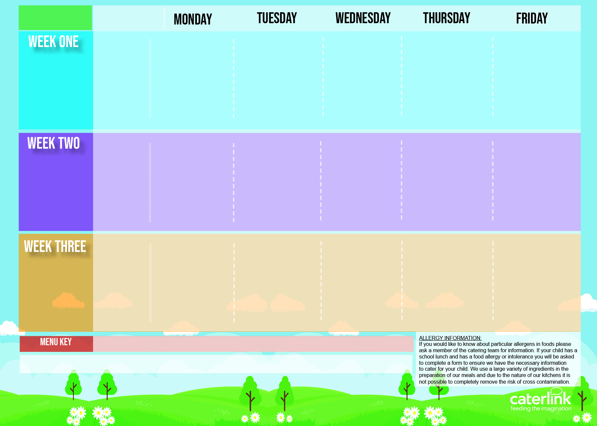
SAIL ACADEMY
Winter Menu 2024 2025
Macaroni Cheese with Garlic Bread | Chicken Korma & Rice | Roast Chicken with Stuffing, Roast Potatoes and Gravy BBQ Chicken Wrap | Cottage Pie | Battered Fish & Wedges
Cheese & Bean Pasty | Sausage Roll |  | Hot Dog | Cheese Omelette
Jacket Potato with Baked Beans, Cheese or Tuna | Jacket Potato with Baked Beans, Cheese or Tuna | Jacket Potato with Baked Beans, Cheese or Tuna | Jacket Potato with Baked Beans, Cheese or Tuna | Jacket Potato with Baked Beans, Cheese or Tuna
Fruit Salad | Apple & Blackberry Crumble & Custard | Melting Moment Biscuits | Carrot and Courgette Cake | Chocolate Orange Cookie
4th Nov 24
25th Nov 24
16th dec 24
20th Jan 25
10th Feb 25
10th March 25
31st March25
Chilli & Rice Cheese & Tom Pizza | Chicken and tomato sauce Pasta Bake with Garlic Bread | Roast Chicken with Stuffing, Roast Potatoes and Gravy | Sausage & Mash with Gravy | Battered Fish & Wedges
 | Breakfast Bap | Potato & Pepper Frittata | Burger in a Bap | Southern Fried Chicken Filled Pitta
Jacket Potato with Baked Beans, Cheese or Tuna | Jacket Potato with Baked Beans, Cheese or Tuna | Jacket Potato with Baked Beans, Cheese or Tuna | Jacket Potato with Baked Beans, Cheese or Tuna | Jacket Potato with Baked Beans, Cheese or Tuna
Fruit Salad | Marble Sponge & Custard | Jelly & Mandarins | Banana Cake | Oaty & Raisin Cookie
11th Nov 24
2nd Dec 24
6th Jan 25
27th Jan 25
24th Feb.25
17th March 25
Macaroni Cheese with Broccoli with Garlic Bread | Chicken & Sweetcorn Pie with Mash & Gravy Hot Dog | Roast Chicken with Stuffing, Roast Potatoes and Gravy | Spaghetti Bolognaise | Battered Fish & Wedges
Fish Finger Bap |  | Chilli with Taco Shells | Chicken, Onion & Pepper Enchiladas | Ham & Cheese Pitta
Jacket Potato with Baked Beas, Cheese or Tuna | Jacket Potato with Baked Beans, Cheese or Tuna | Jacket Potato with Baked Beans, Cheese or Tuna | Jacket Potato with Baked Beans, Cheese or Tuna | Jacket Potato with Baked Beans, Cheese or Tuna
Fruit Salad | Sticky Toffee Apple Crumble & Custard | Chocolate & Beetroot Brownie | Iced Sponge | Vanilla Shortbread
18th Nov 24
9th Dec 24
13th Jan 25
3rd Feb. 25
3rd March 25
24th March 25
Available Daily: Fresh Bread – Salad Selection, – Fresh Fruit and Yoghurt,

